Slide 1
Political Parties and their Roles in the Parliament
Key Stage 4

Slide 2









Guess these Logos…

Slide 3


What is a political party?
an association of individuals who share similar political goals and viewpoints and works to elect its candidates to public office to influence public policy.
essential components of parliamentary democracies, providing a structured framework for political competition, representation, and governance.

Slide 4






The Role of Political Parties in a Democracy
Representation
Policy Formulation
Legislation and Governance
Political Stability and competition
Accountability
Facilitating Public Participation
Notes:
What is the role of political parties in a democracy?
Political Parties help translate the will of the people into policies and actions through the democratic process in various ways:
Representation: Political parties represent the interests, values, and concerns of different sections of society. Through the electoral process, parties present candidates who, if elected, become representatives of the people in the parliament.
Policy Formulation: Political parties develop and articulate policies on various issues to reflect the party's ideology, values, and the preferences of its supporters. Once in power, the ruling party or coalition implements these policies through legislation and governance.
Legislation and Governance: Members of parliament affiliated with political parties debate proposed laws, contribute to policy discussions, and vote on legislation. Additionally, party members often hold executive positions in the government, helping to implement policies and administer public affairs.
Political Stability and competition: Through elections, parties offer voters a clear choice, and the winning party or coalition is tasked with providing stable governance.
Accountability: Opposition parties scrutinize the actions and policies of the ruling party, question government decisions, and propose alternative policies. This contributes to a system of checks and balances, ensuring that those in power are answerable to the public.
Facilitating Public Participation: Parties engage in election campaigns to inform voters about their policies, ideologies, and candidates. These campaigns help voters make informed choices and contribute to shaping the direction of the country.

Slide 5
Political Party Composition of 20th People’s Majlis:
Minority Party (12 MPs)
MDP (12)
Independents (2)
Majority Party (75 MPs)
PNC (75)
JP (1)
MDA (2)
MNP (1)
MNP (1)
Notes:
Role of Political Parties in Majlis
Members representing political parties in Majlis refers:
MPs who have been elected to parliament using a particular political party ticket
MPs who join political parties after parliamentary election, and decide to represent a particular political party in the parliament.

Slide 6
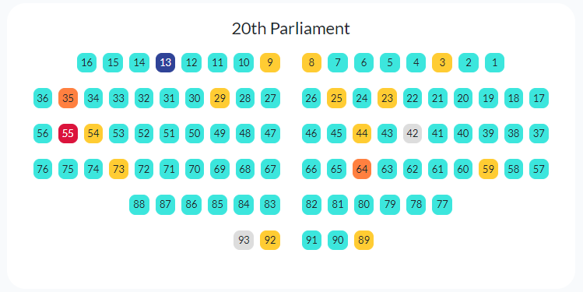
Political Party Composition of 20th People’s Majlis:
Notes:
Role of Political Parties in Majlis
Members representing political parties in Majlis refers:
MPs who have been elected to parliament using a particular political party ticket
MPs who join political parties after parliamentary election, and decide to represent a particular political party in the parliament.

Slide 7

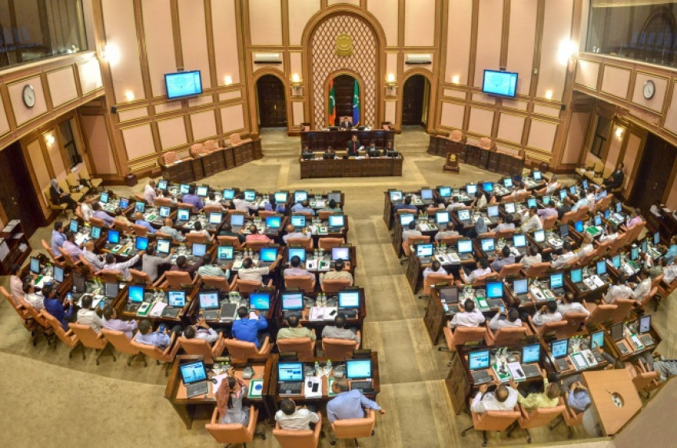
Food for Thought…
What is a Multi-party system?
Majority Leader?
Minority Leader?
Parliamentary Group Leader?
Party whips?
Independent MP?
Notes:
Multi-party systems provide a more diverse representation of political ideologies and interests, allowing citizens to have a broader range of choices and ensuring that a wider spectrum of views is considered in decision-making. Majlis ensures this representation through the following mechanisms.
Majority Leader - the ranking member representing the party or parties controlling the most number of seats in Majlis.
Minority Leader - the ranking member representing the party or parties controlling the second most number of seats in Majlis.
Parliamentary Group Leader - member who determines the will of each political party represented in the Majlis during the debates and other matters
Party whips - members who have been selected by the Parliamentary Group Leader to support the Parliamentary Group Leader in enforcing the will of the political party. When the number of members of a party represented in the Majlis exceeds five, then a party whip will be determined. There must be a party whip for every 10 members of the political party.
Independents: MPs who do not represent any political parties are called Independents.

Slide 8

Activity: form a Political Party and create a poster
Name and logo for the Party
Colour to represent Party
Slogans, if any
Basic principles and philosophies (their values or what they stand for)
Select Party leaders like President, Vice President, Parliamentary Group Leader, etc

